Slide 1

Rutherford Scattering Experiment
Sameen Yunus
03/14/2018
Lab Partner: Gabe Otero

Slide 2
Introduction
What is Rutherford scattering?
History and importance of Rutherford scattering
Theory of the Rutherford model
Differential cross section
Experimental setup
Analysis techniques
Determining Z – atomic number of gold
Further topics:
Multiple scattering
Energy losses

Slide 3
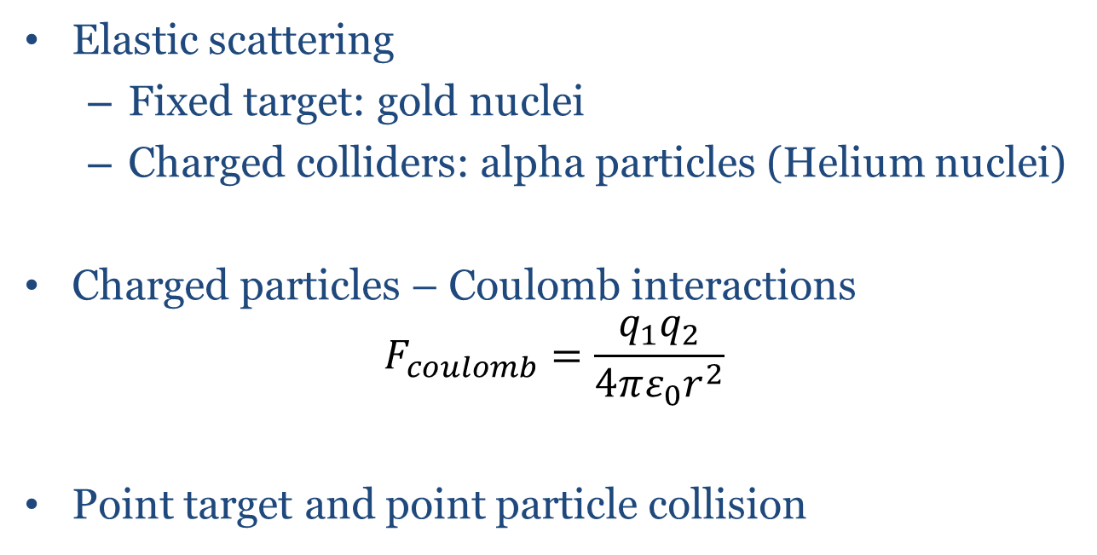
What is it?
Elastic scattering
Fixed target: gold nuclei
Charged colliders: alpha particles (Helium nuclei)
Charged particles – Coulomb interactions
$$F_{coulomb}=\frac{q_{1}q_{2}}{4πε_{0}r^{2}}$$
Point target and point particle collision

Slide 4

Historical model
1904: J. J. Thomson’s plum pudding model was the leading contender
Neutral atom
Does not explain quantized nature of Hydrogen spectrum
Positive charge cloud with localized electrons. Image courtesy of Wikipedia [1]

Slide 5
1909: Geiger and Marsden (or the merits of Undergraduate research)
Hans Geiger and Ernest Marsden performed the thin gold foil experiment
Problem: how are positive and negative charges arranged?
Electron mass and charge were well known
Probe atomic structure with α-particles
Plum pudding model: expect small scattering angles
Observe: α-particles scattered above angles of 90°

Slide 6
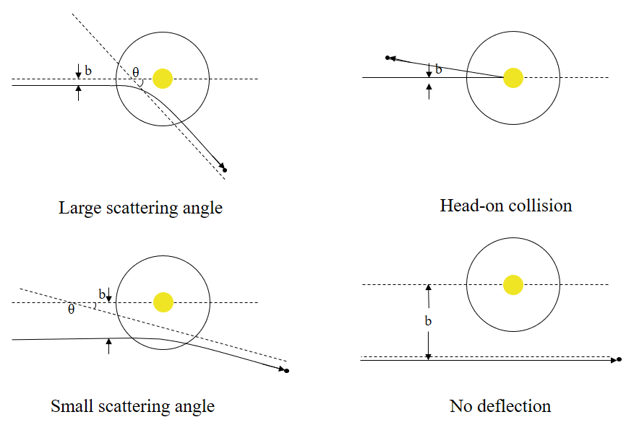

Slide 7
1911: Rutherford proposes a new model
Plum pudding model: positive charge can’t cause large angle scattering
Positive charge must be greater than α-particle
Concentrated because low counts at large angles
The Rutherford Model is born
Concentrated, positively charged nucleus
Surrounded by small, negatively charged electrons

Slide 8
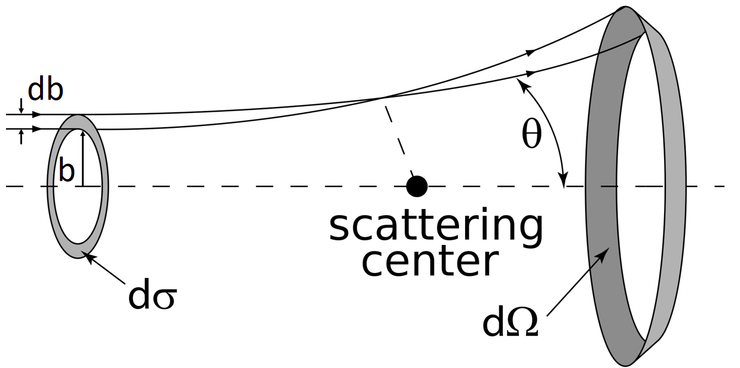
Differential Scattering Cross Section
Fraction of particles that are scattered into a particular solid angle at a given direction relative to the incoming beam
Derivation:
Newtons equations of motion for a particle interacting with a central potential.
Conservation of angular momentum
Center of mass frame
Image courtesy of Wikipedia [2]

Slide 9
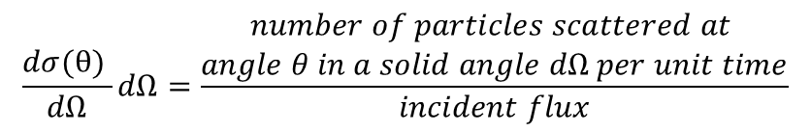
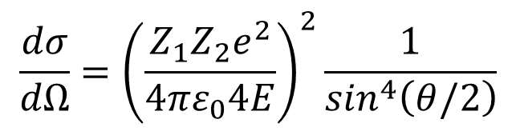
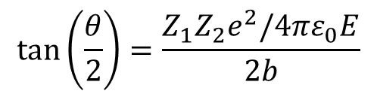
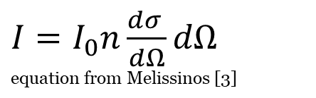
Useful relations for analysis
The Rutherford Scattering formula
$$\frac{dσ}{dΩ}={\left(\frac{Z_{1}Z_{2}e^{2}}{4πε_{0}4E}\right)}^{2}\frac{1}{\sin^{4}\left(θ/2\right)}$$
Flux and scattering cross section relation
$$\frac{dσ(θ) }{dΩ}dΩ=\frac{\begin{aligned}number of particles scattered at \\ angle θ in a solid angle dΩ per unit time\end{aligned}}{incident flux}$$
$I=I_{0}n\frac{dσ }{dΩ}dΩ$
equation from Melissinos [3]
Impact parameter and scattering angle relation
$$tan⁡\left(\frac{θ}{2}\right)=\frac{Z_{1}Z_{2}e^{2}/4πε_{0}E}{2b}$$

Slide 10
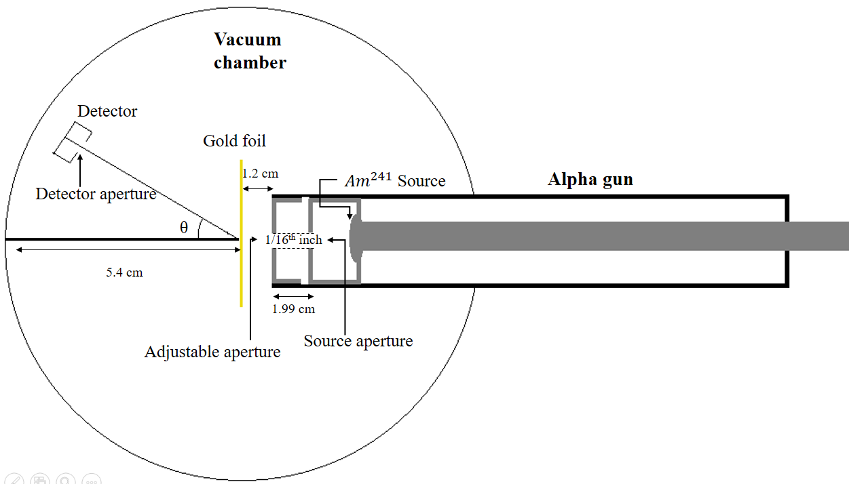
Experimental setup
Source of α-particles: 241 Americium at 130μCu
Energy*: 5.49 MeV (86%), 5.44 MeV (13%), and 5.39 MeV (1.3%)
Foil: 2 layers, thickness is 2.72 ± 0.16 μm
Detector: Silicon PN-Junction semiconductor detector
Source, foil and detector are enclosed in a vacuum chamber
α-particles are easily attenuated in air, range: ∼cm at atmospheric pressure
*We use E = 3.77 MeV as outlined by the lab writeup

Slide 11
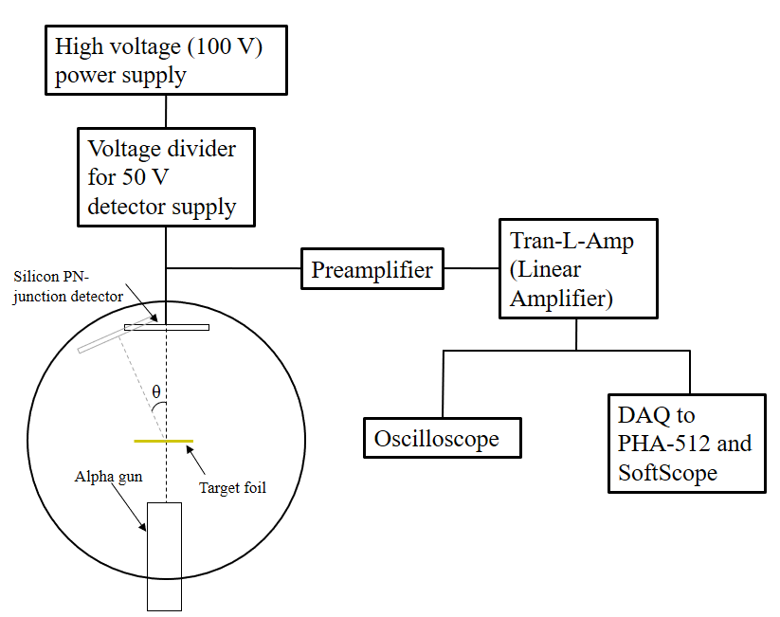

Slide 12
Equipment
High voltage power supply: provides 100 V
Voltage divider: PN detector bias is 50 V, use a voltage divider
Vacuum chamber and pressure gauge: used to make sure a proper vacuum is created for data taking
PN Detector: discussed later
Low noise current pre-amp: Used to amplify the signal from detector and increase the signal to noise ratio.
Linear amplifier: amplifies and shapes the pulse
PHA 5124: Pulse height analyzer

Slide 13
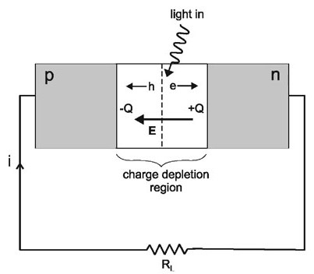
Semiconductor detectors
Use electron-hole pairs as information carriers.
Incoming radiation: α-particles
Ionizes the silicon
Create electron-hole pairs
Electrons move to the n-type material
Holes move to the p-type material
Charge depletion -> Current
Current, or voltage produced from this process is proportional to the ionizing radiation
Image courtesy of Quimby [4]

Slide 14
Linear amplifier unit
Coarse and fine gain effect how much the original signal is amplified
Higher gain means signals will be sorted over higher range of potentials
Too high gain: will lose signal
Output can be calibrated to gamma ray energies
Differentiator (Δt) and integrator (Σt) circuits shape the pulse
DIFF:1.0 µs, INT:0.05 µs, Coarse Gain:100, and Vennier Gain: 6.1

Slide 15
Pulse Height Analyzer
Input is the amplified signal from the detector
Counts pulses over a certain bias and below the maximum
Each voltage (energy) is measured on a specific channel
Over each 10 minute range, sums hits at each voltage
Plots the spectrum
Range: 0.3V to 5V,
Integration time: 10 minutes
Sampling rate: 5×10⁶ Hz

Slide 16
Background – without α
Due to contamination of the vacuum chamber and noise in the detector and electronics.
Remove α-gun and gold foil
Measure counts on the detector
t = 20 minutes
N = 0
Did not have time for an overnight background detection but we don’t expect it to be very big

Slide 17
Background – with α
No foil
Span over angles between 0° and 25°
In order to get an idea of where true zero of the detector is
High angles, short t gives background for α-gun
Subtract these counts from all angles
At 25°
No foil
N = 14
t = 10 minutes
I = 1.4 counts/minute

Slide 18
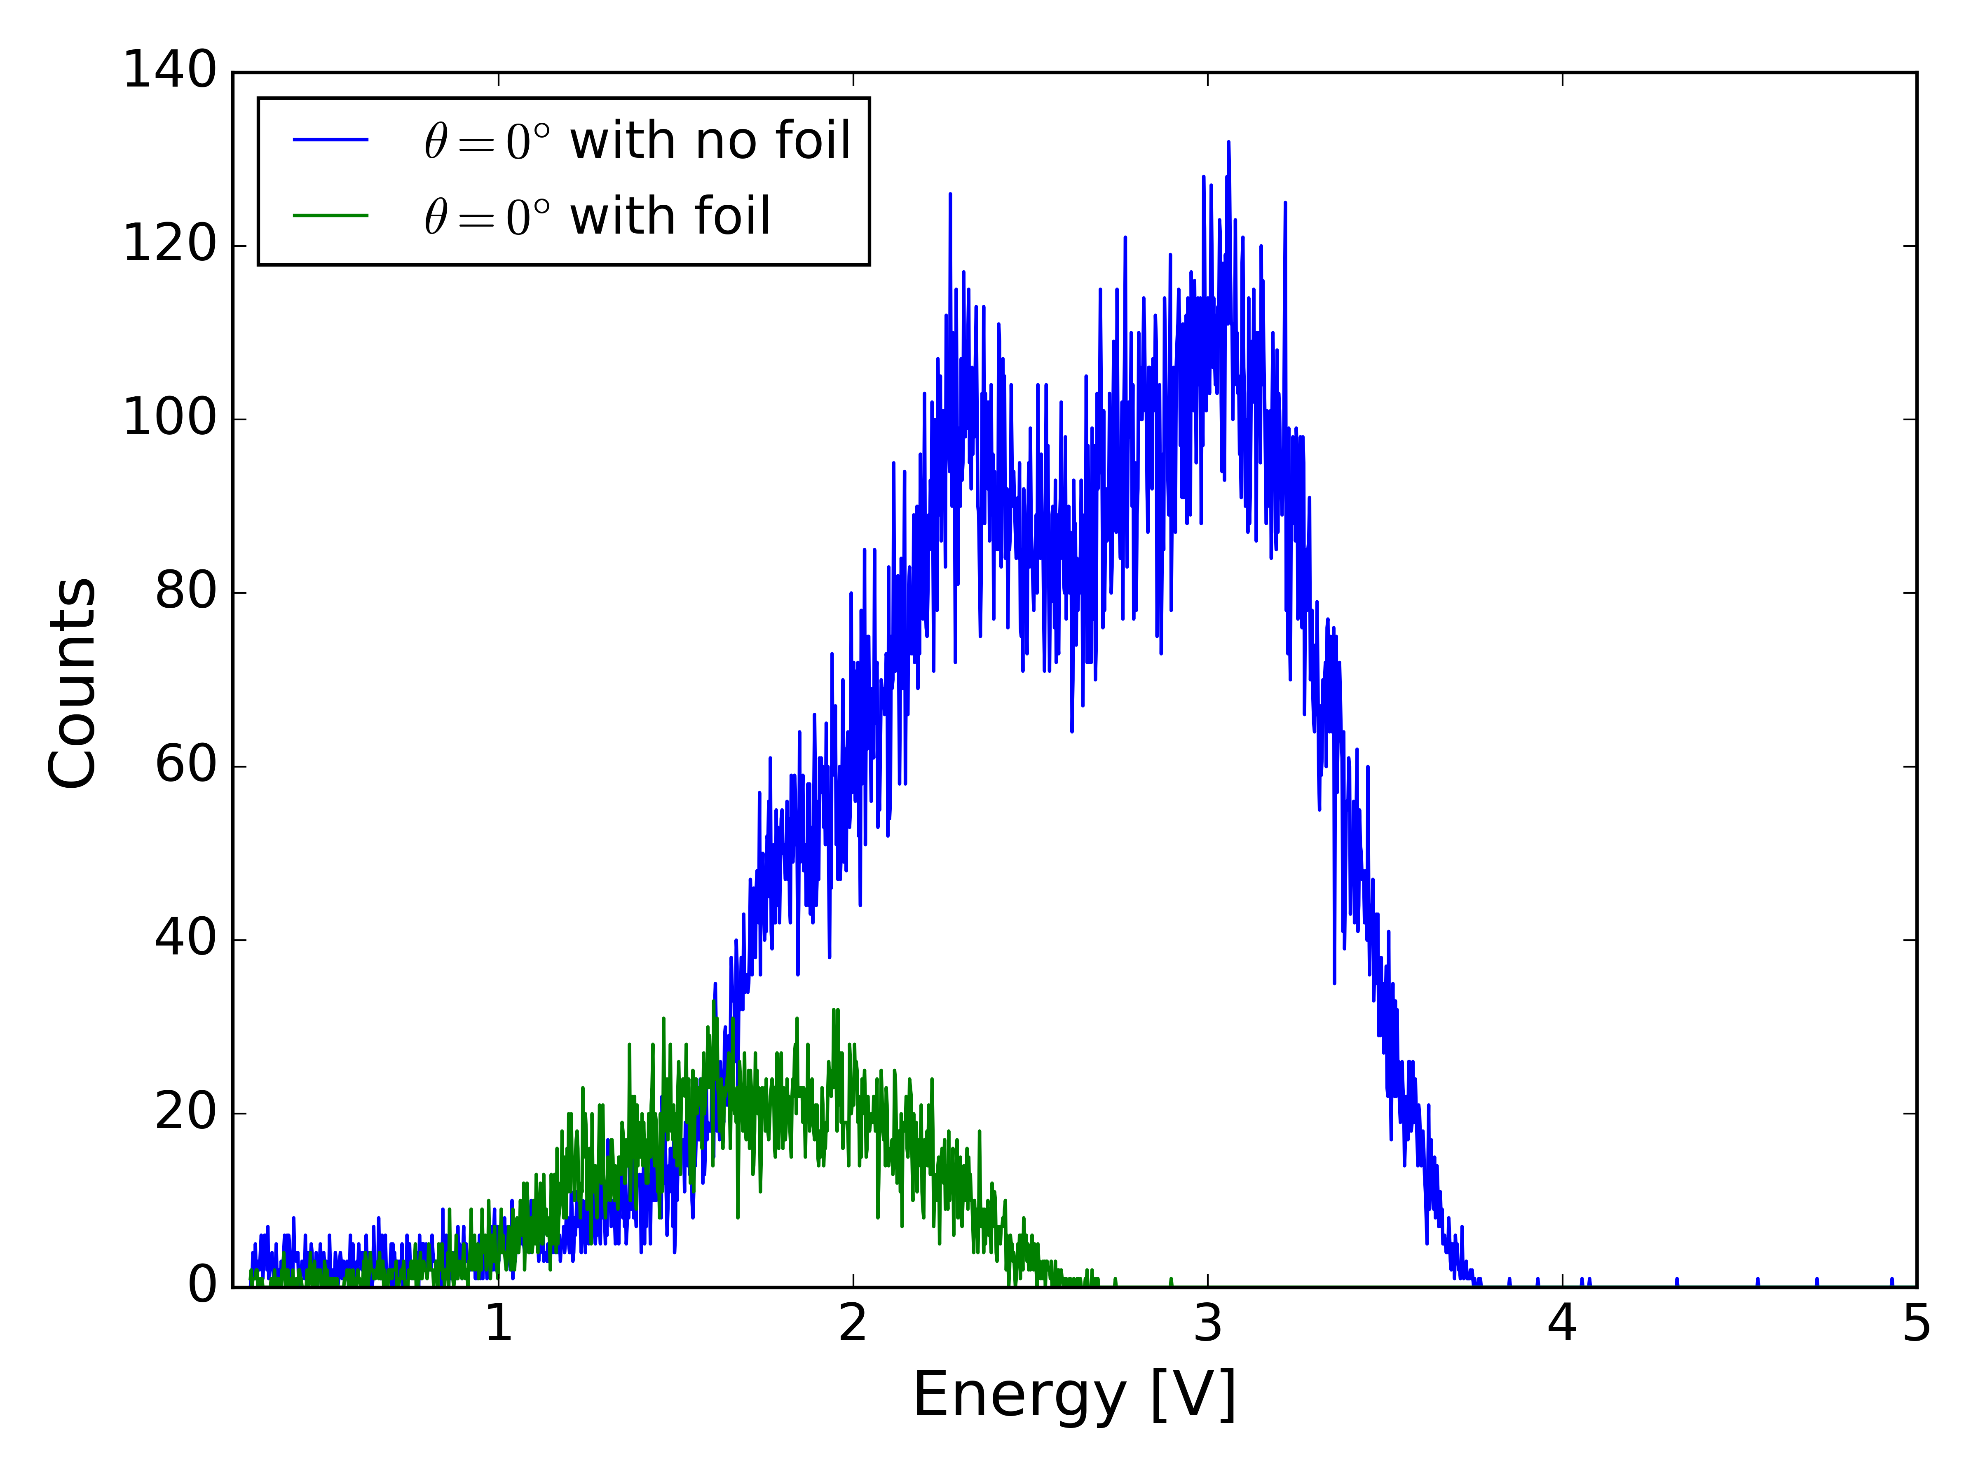
Background – Instrumental Making reliable cuts
Integrate over the curve to find N, divide by t to find I
Reliable data only: choose how to cut out useless counts

Slide 19
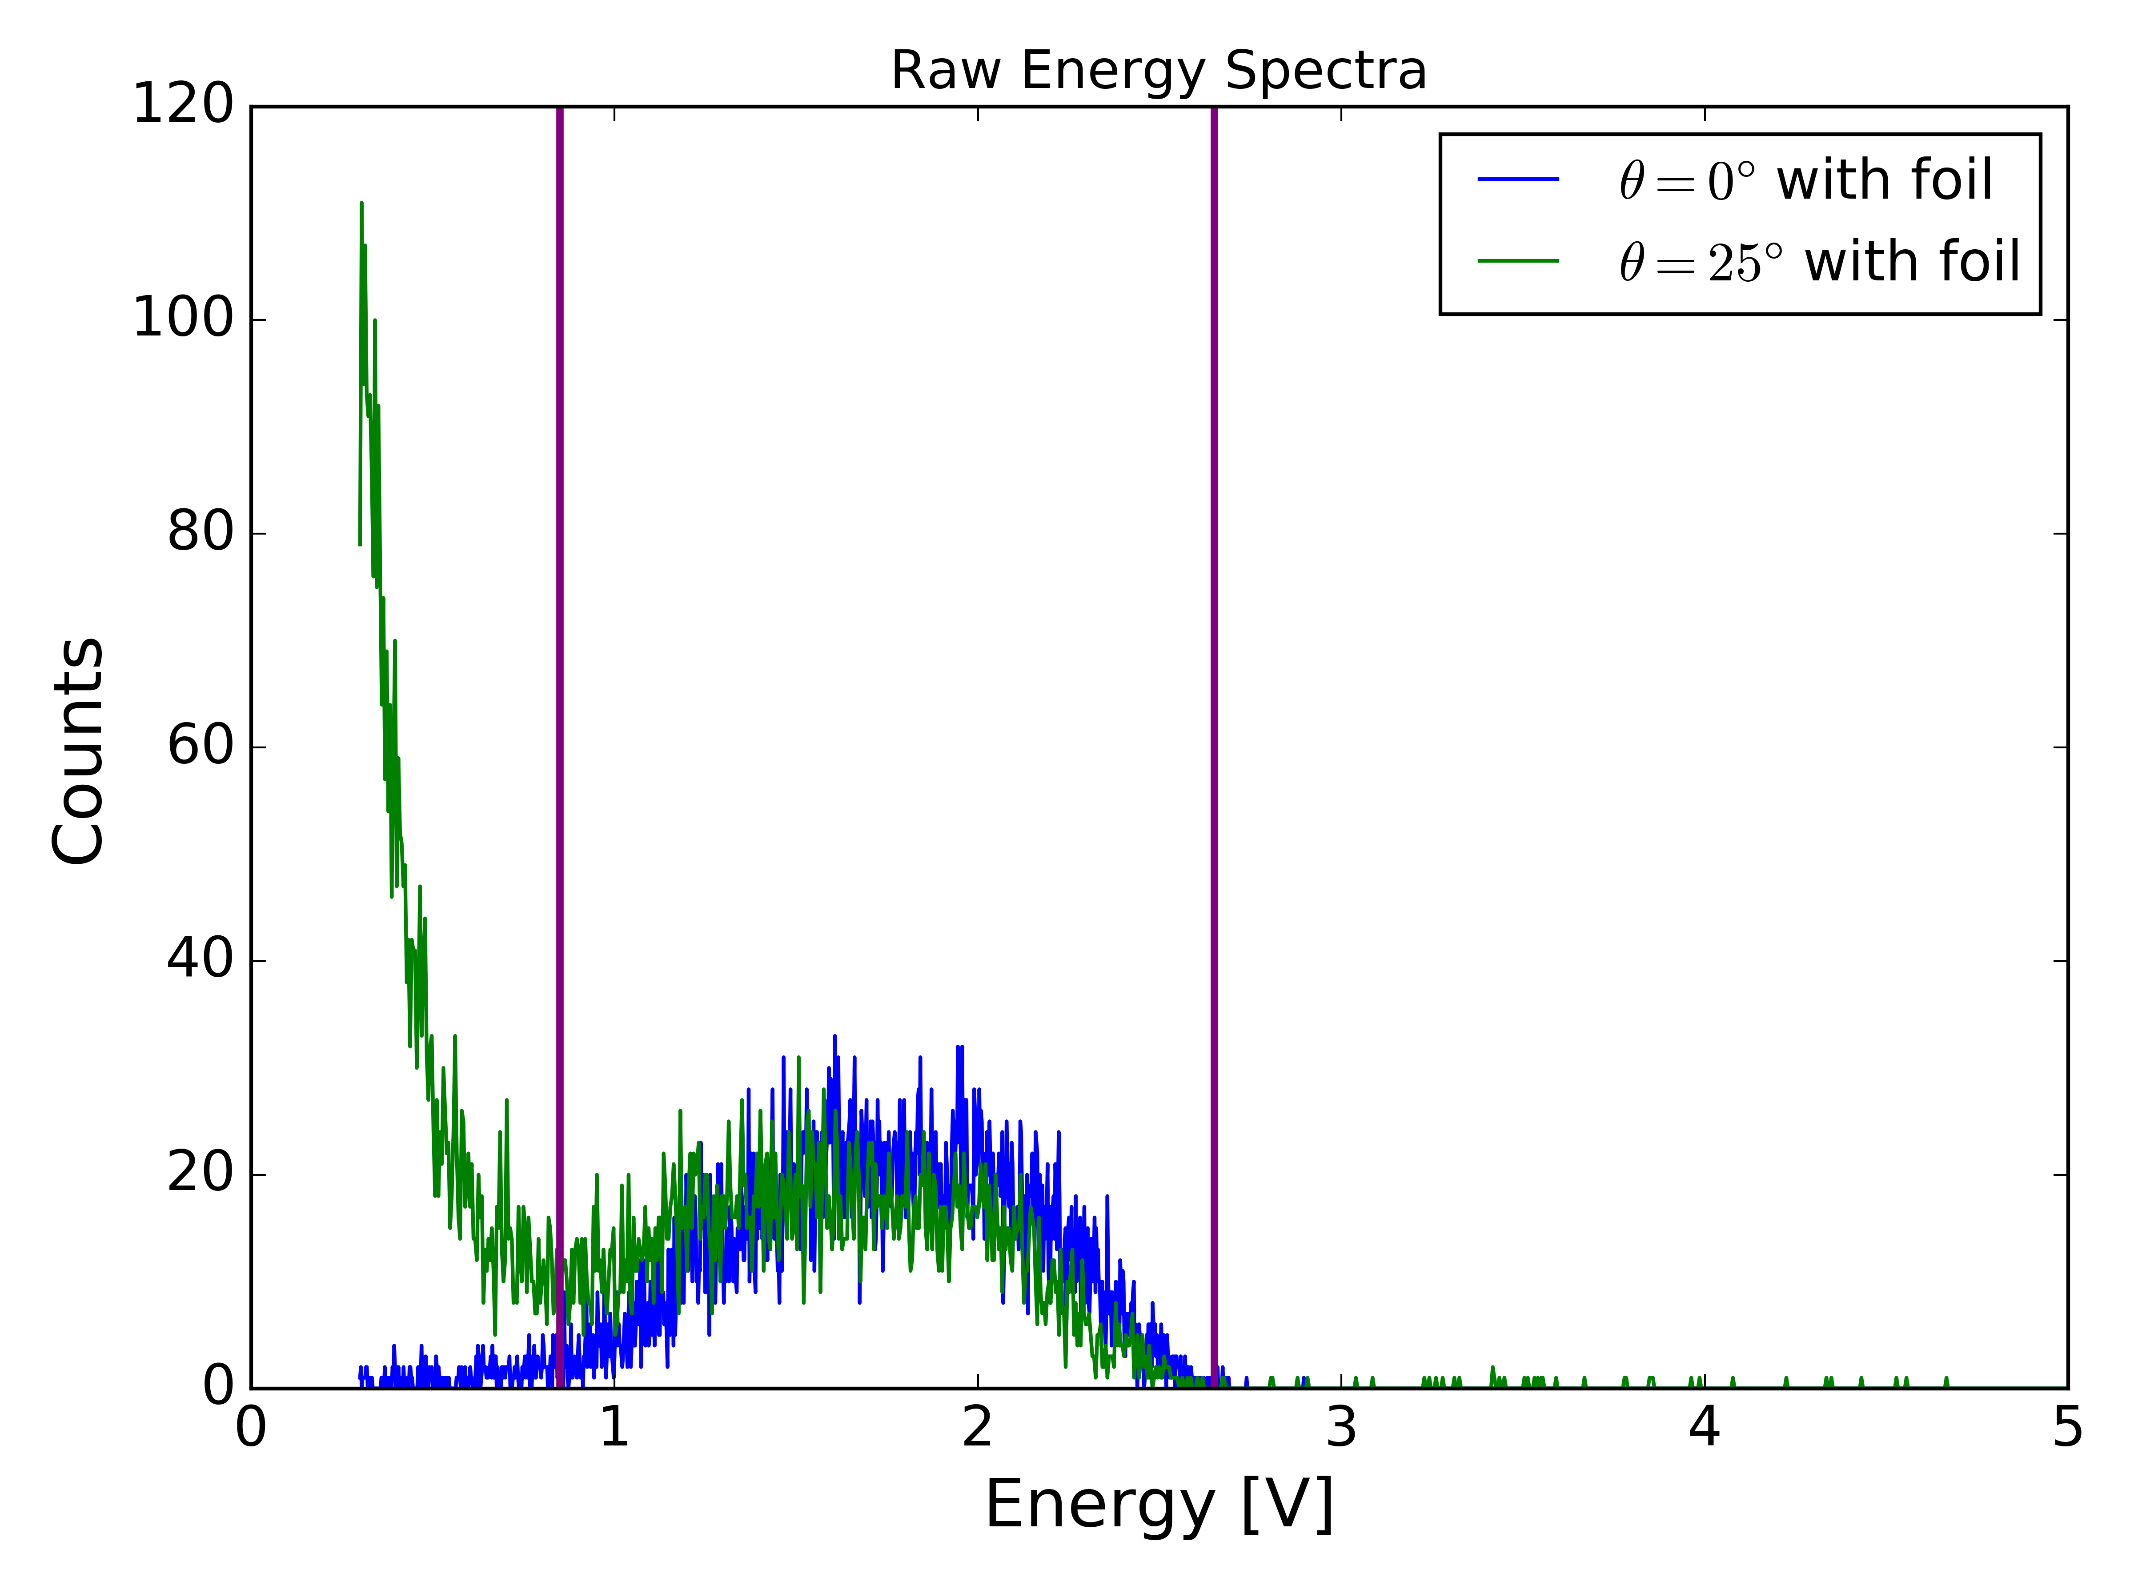
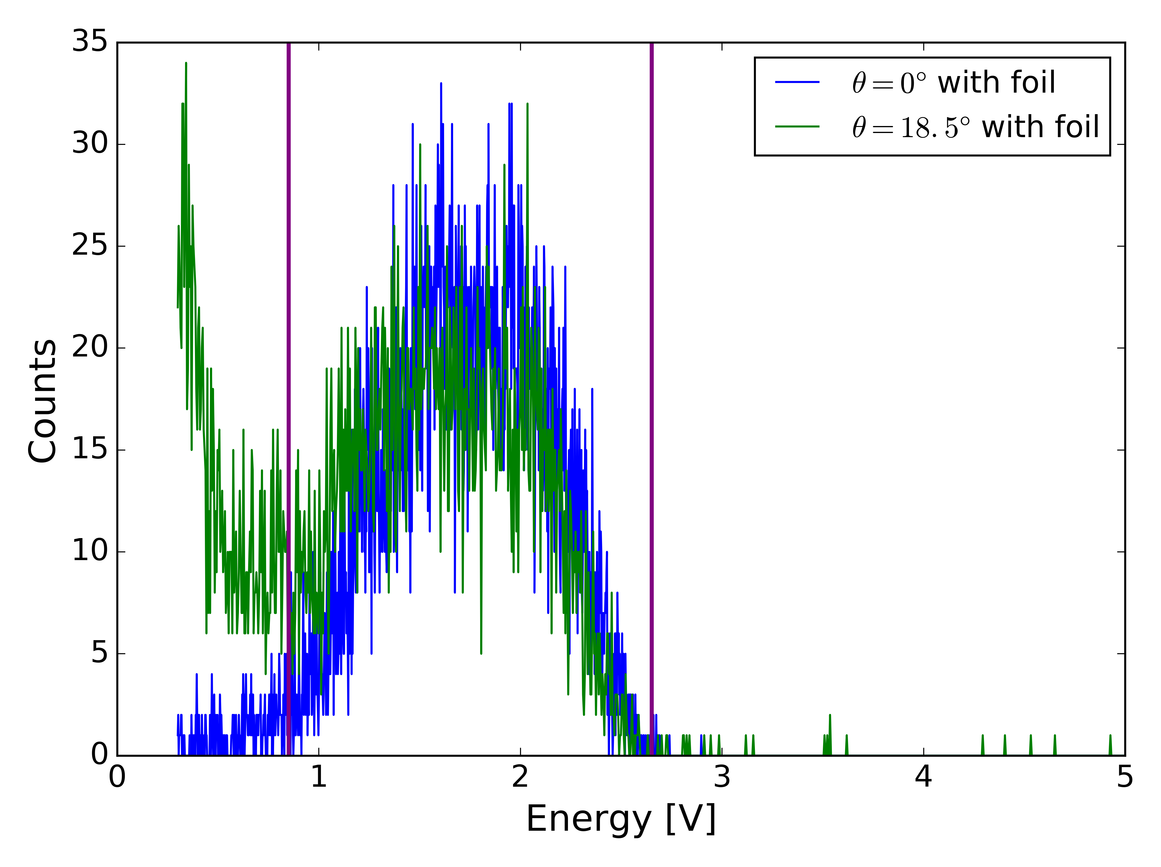
At low voltage build up of counts for t ≥ 2hrs
What could cause this?
Dark current
Undepleted detector
Cosmic rays
Other sources from electronics

Slide 20
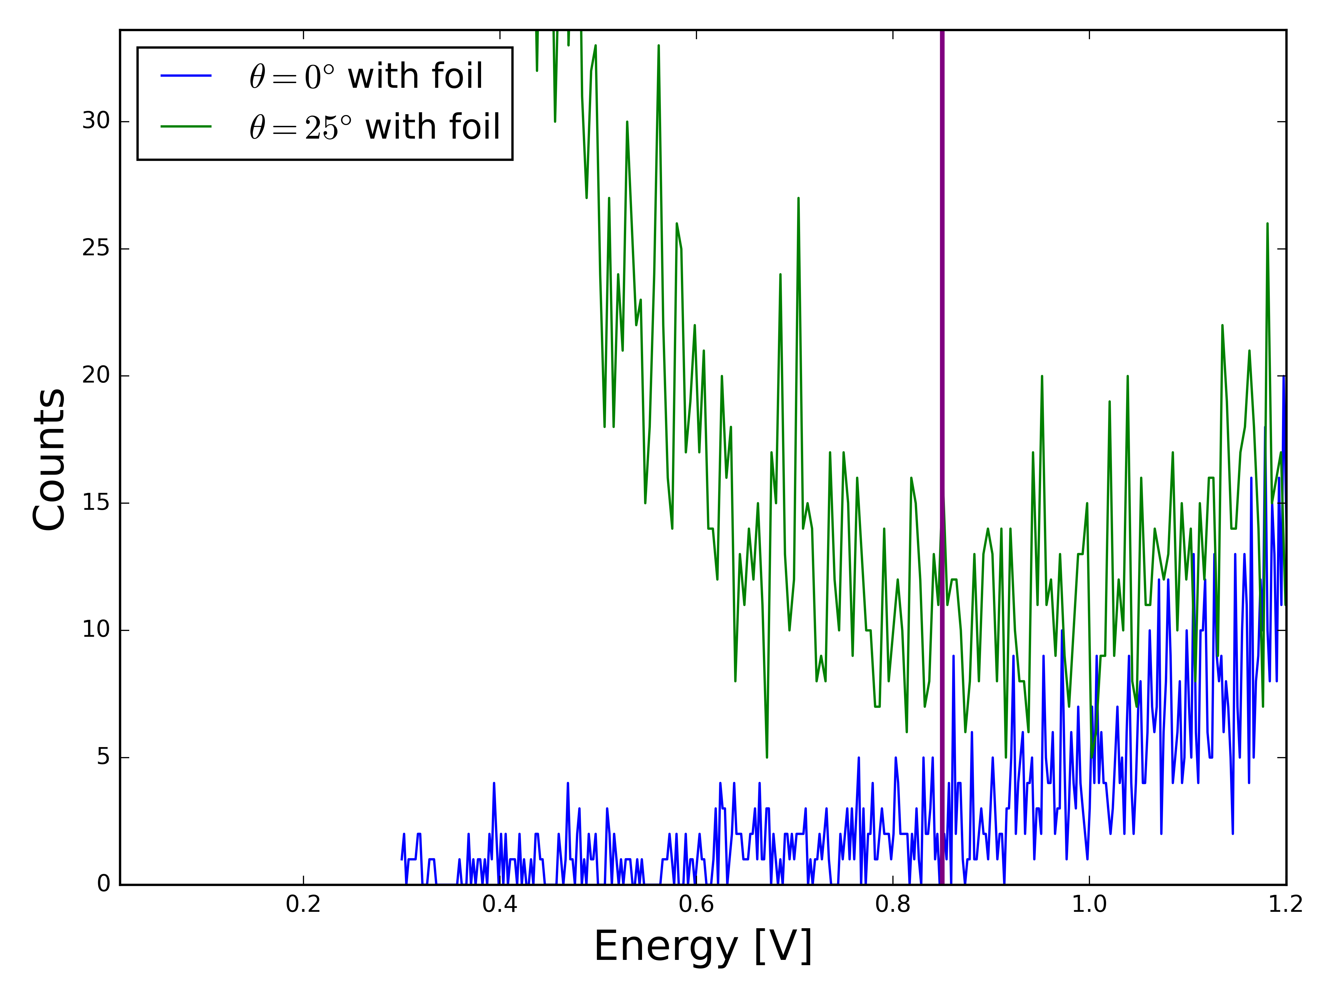
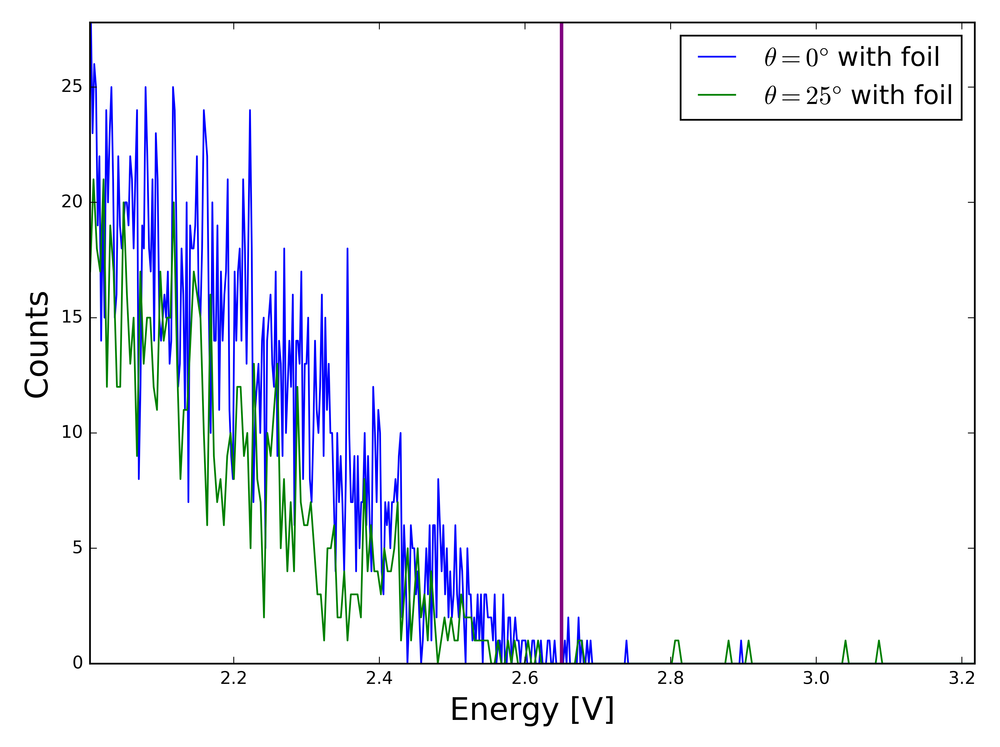
Find where counts go to zero
Apply cuts at 0.85V and 2.65V
Same for all angles

Slide 21
Finding “true zero”
Measuring angles: where detector lines up with protractor.
Not necessarily true zero value (where counts are highest)
Spanning method
Small to large angles, no foil
Get counts to see where they peak
Calibrating Dial indicator
At 0° on protractor
Find what dial indicator reads
Gaussian peak fitting
Fit experimental data
Find μ

Slide 22
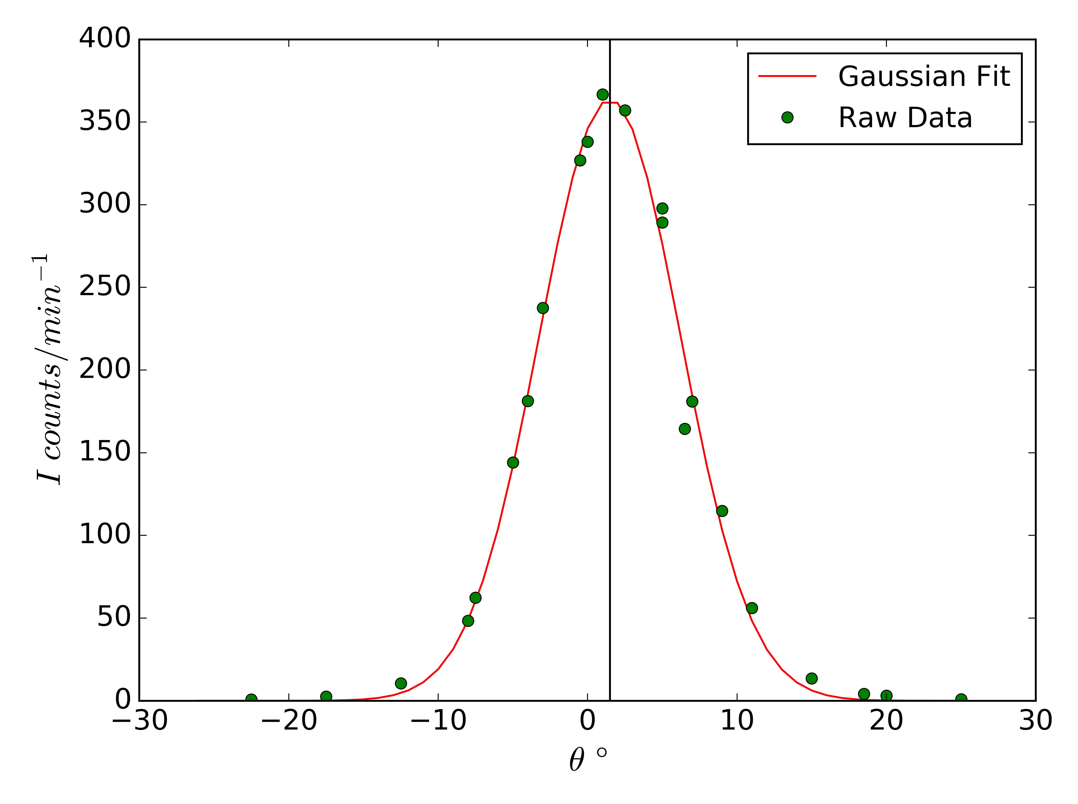
Gaussian peak fitting
Plot angles versus counts per time.
Should obey a gaussian
Fit to the data and find the mean μ (centroid)
Zero at ∼1±0.5°

Slide 23
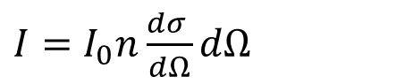
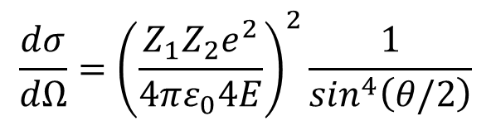
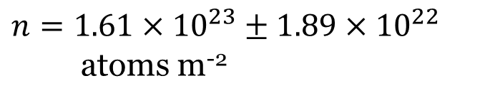
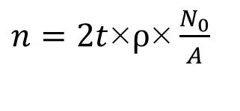
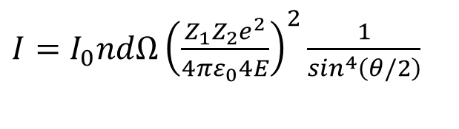
Exploring experimental data
$$\frac{dσ}{dΩ}={\left(\frac{Z_{1}Z_{2}e^{2}}{4πε_{0}4E}\right)}^{2}\frac{1}{\sin^{4}\left(θ/2\right)}$$
$I=I_{0}n\frac{dσ }{dΩ}dΩ$
$I=I_{0}ndΩ{\left(\frac{Z_{1}Z_{2}e^{2}}{4πε_{0}4E}\right)}^{2}\frac{1}{\sin^{4}\left(θ/2\right)}$
$n=2t$×$ρ\text{×}\frac{N_{0}}{A}$
t = 2.72 ± 0.16 μm (thickness)
ρ = 19.32 g/cm³ (density of gold)
N₀ = 6.022×10²³ (Avogadro’s number)
A = 197 AMU or 3.27×10-²⁵ (mass of gold nuclei)
$n=1.61×{10}^{23}±1.89$ $×{10}^{22}$ atoms m⁻²

Slide 24
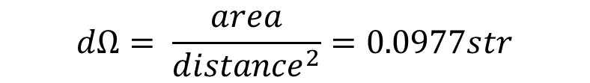
I₀ is measured: I₀ = 2252.567 min⁻¹
Solid angle
Note: radius of detector aperture is 0.9525 cm
distance between foil and detector is 5.4 cm
$$dΩ= \frac{area}{{distance}^{2}}=0.0977str$$
Z₁ is simply the atomic number of Helium: 2
Z₂ is the atomic number of gold, we want to determine this
E = 3.77 MeV
Now let
$K=I_{0}NdΩ{\left(\frac{Z_{1}e^{2}}{4πε_{0}4E}\right)}^{2}=1.29×{10}^{−6}±1.51×{10}^{−7} \text{min}\text{−}\text{1}$

Slide 25
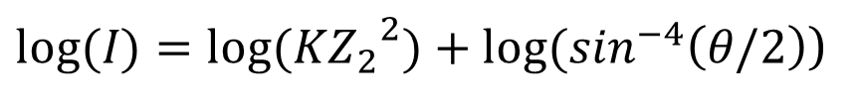
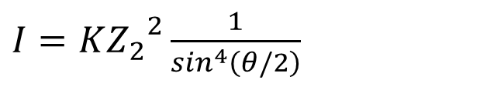
Our experimental data is I and θ
$I=K{Z_{2}}^{2}\frac{1}{\sin^{4}\left(θ/2\right)}$
We plot I vs sin(θ/2) to study the x⁻⁴ dependence of the counts (and the differential cross section)
To find Z₂ we want to make a linear fit and find the slope and intercept.
In order to do this we look at the above equation in log-log scale
Use the intercept to find Z₂
$log⁡(I)=log⁡(K{Z_{2}}^{2})+log⁡(\sin^{−4}\left(θ/2\right)$)

Slide 26
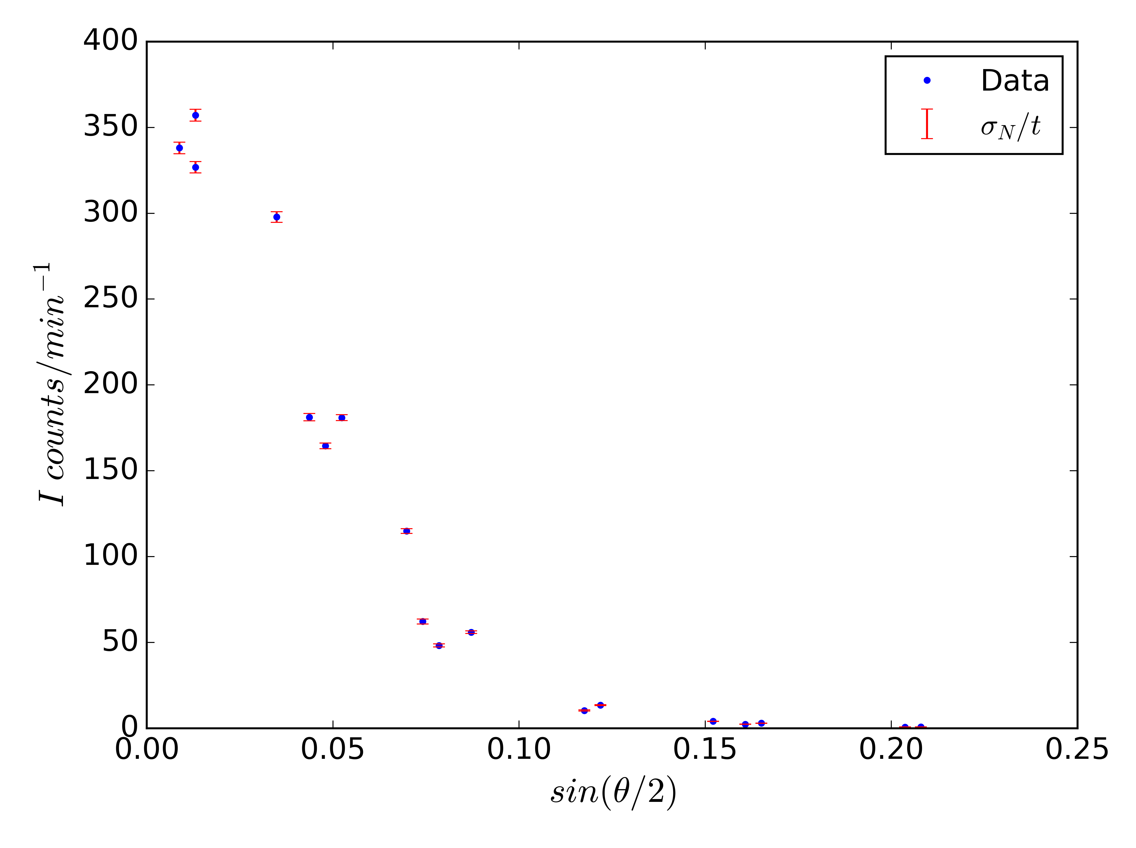
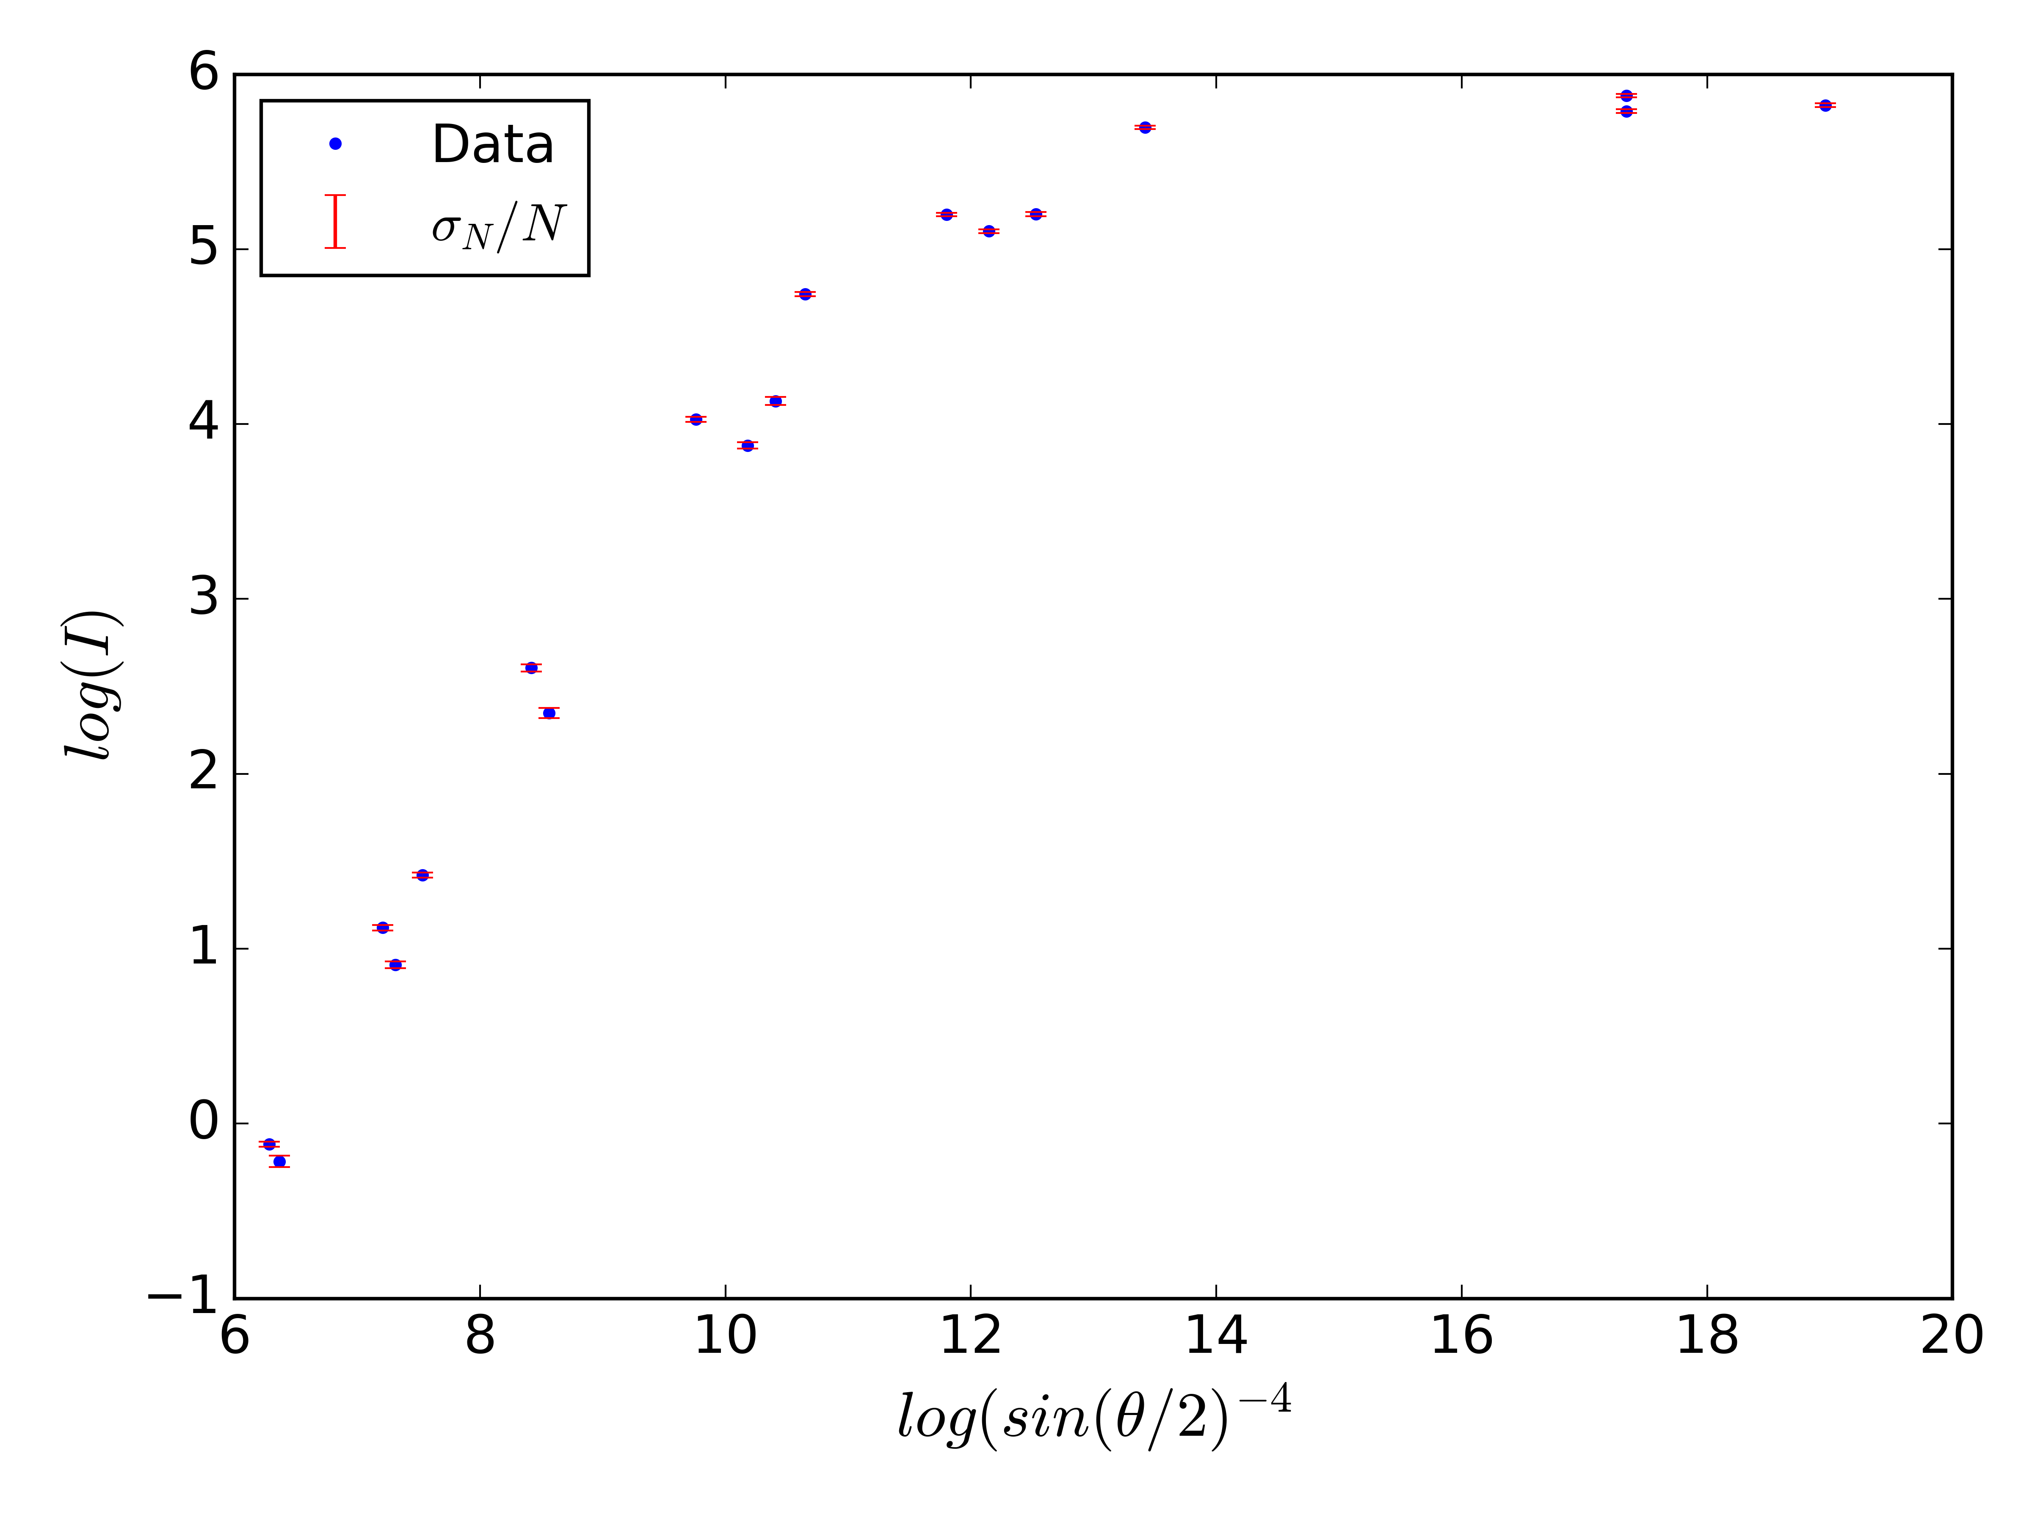
Limiting the scattering angles
Asymptotic behavior in log scale where points close together

Slide 27
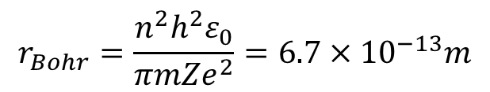
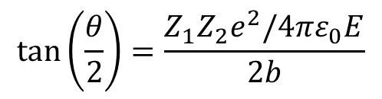
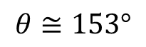
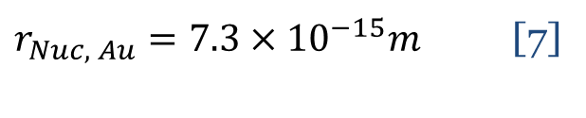
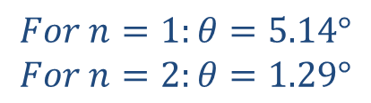
The differential cross section increases rapidly for small angles
Small angles – large impact parameter, screening by electrons
Use Bohr radius with Z = 79 as impact parameter
$$r_{Bohr}=\frac{n^{2}h^{2}ε_{0}}{πm{Ze}^{2}}=6.7×{10}^{−13}m$$
Detour: related source of error
Does non-zero size of nucleus matter for our analysis?
This is not significant for our analysis
$$tan⁡\left(\frac{θ}{2}\right)=\frac{Z_{1}Z_{2}e^{2}/4πε_{0}E}{2b}$$
$r_{Nuc, Au}=7.3×{10}^{−15}m$ [7]
$$For n=1:θ=5.14°$$
$$For n=2:θ=1.29°$$
$$θ≅153°$$

Slide 28
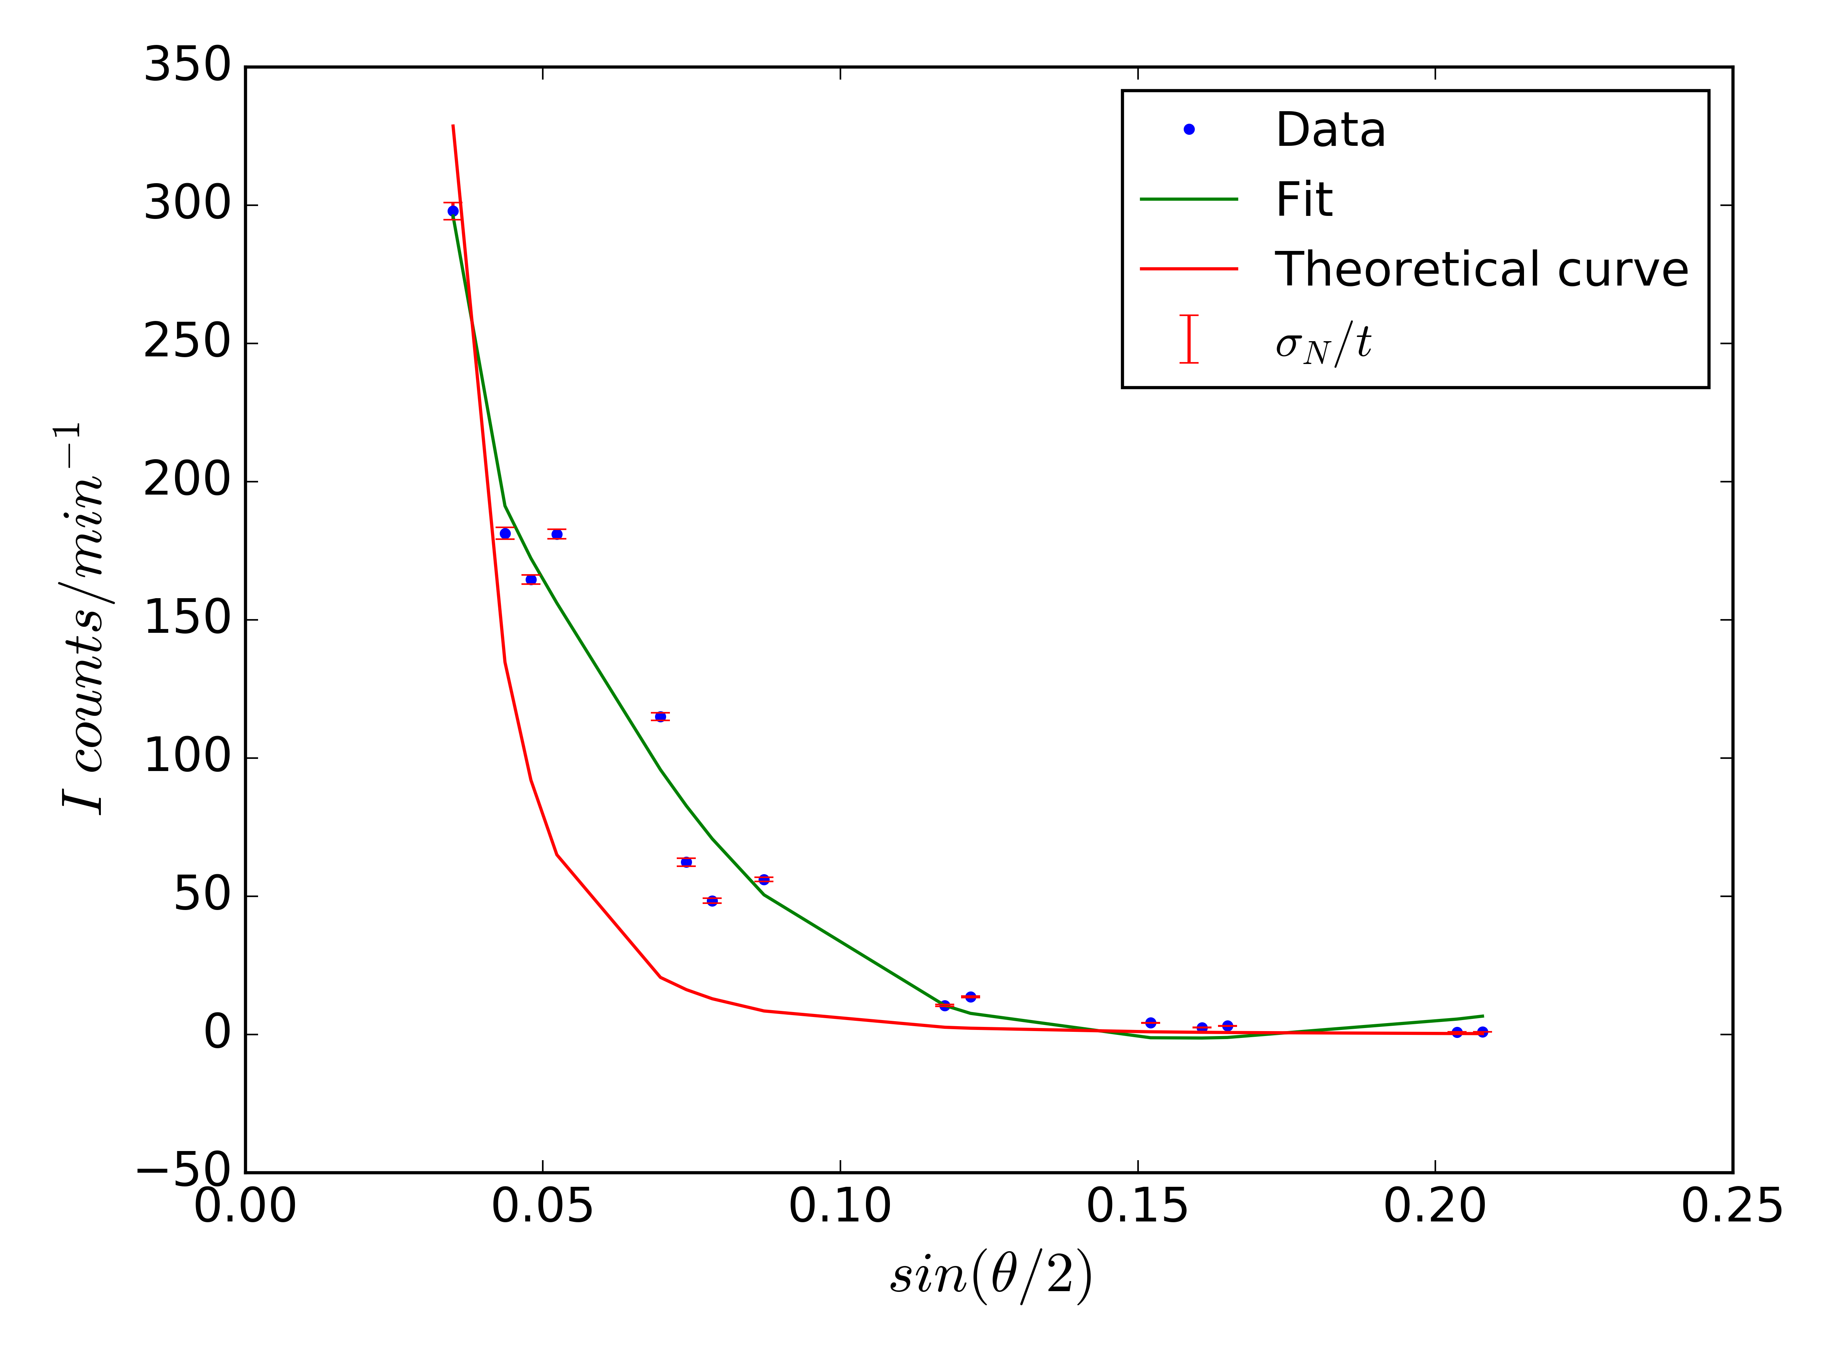
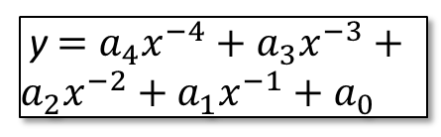
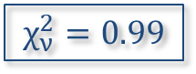
I vs sin(θ/2)
We fit our data with the following curve where y = I, x = sin(θ/2), and the coefficients come from a Python fitting function:
$$χ_{ν}^{2}=0.99$$
y $=a_{4}x^{−4}+a_{3}x^{−3}+a_{2}x^{−2}+a_{1}x^{−1}+a_{0}$

Slide 29
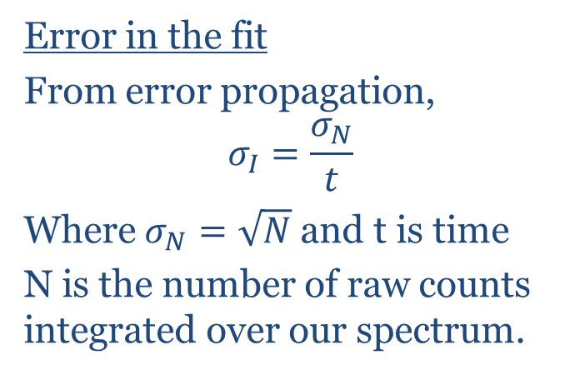
Error and fit
We observe the x⁻⁴ dependence
Coefficients
a₄ = 0.00542±0.00143 min⁻⁴
a₃ = -0.366±0.0775 min⁻³
a₂ = 8.671±1.37 min⁻²
a₁ = -71.3±9.18 min⁻¹
a₀ = 186±20.3 min⁻¹
Error in the fit
From error propagation,
$$σ_{I}=\frac{σ_{N}}{t}$$
Where $σ_{N}=\sqrt{N}$ and t is time
N is the number of raw counts integrated over our spectrum.

Slide 30
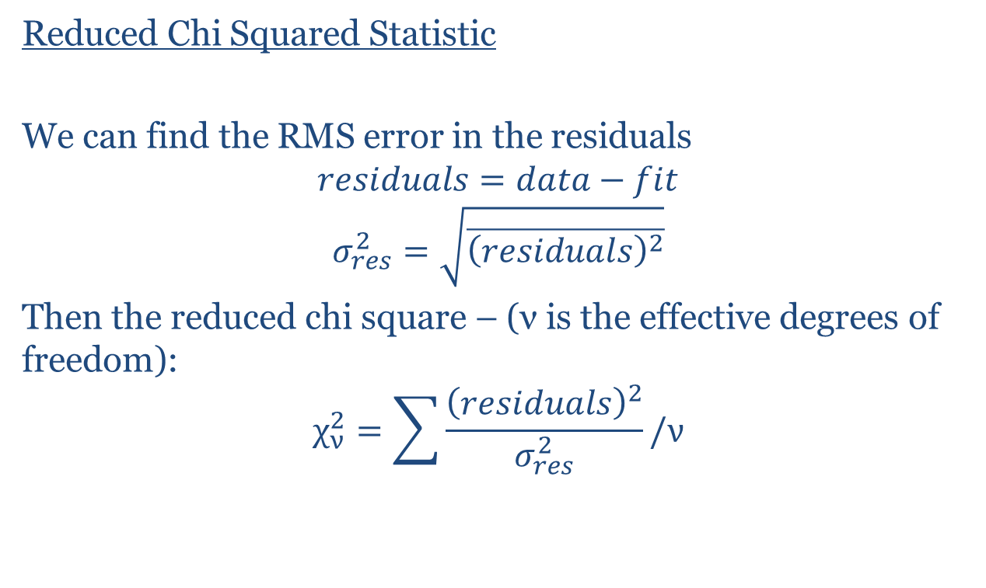
Goodness of fit
Reduced Chi Squared Statistic
We can find the RMS error in the residuals
$$residuals=data−fit$$
$$σ_{res}^{2}=\sqrt{\overline{{\left(residuals\right)}^{2}}}$$
Then the reduced chi square – (ν is the effective degrees of freedom):
$$χ_{ν}^{2}=\sum{\frac{{\left(residuals\right)}^{2}}{σ_{res}^{2}}}/ν$$

Slide 31
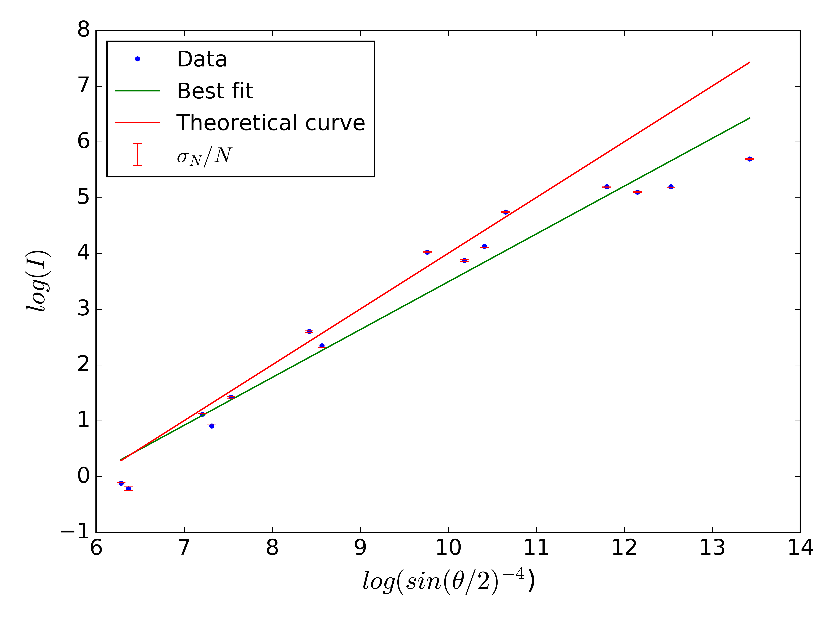
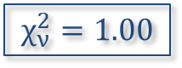
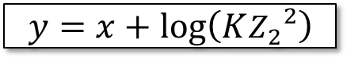
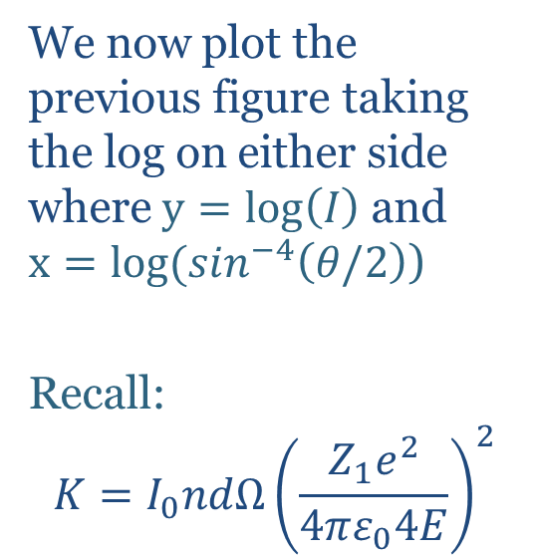
Linear fit of logarithmic equation
We now plot the previous figure taking the log on either side where $y=\log\left(I\right)$ and $x=log⁡(\sin^{−4}\left(θ/2\right)$)
Recall:
$$K=I_{0}ndΩ{\left(\frac{Z_{1}e^{2}}{4πε_{0}4E}\right)}^{2}$$
$$χ_{ν}^{2}=1.00$$
$$y=x+\log\left(K{Z_{2}}^{2}\right)$$

Slide 32
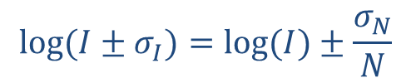
Error and fit parameters
We can propagate the error in a logarithmic function, as we did in the error analysis exercise to get:
$${log⁡(I±σ}_{I})=log⁡(I)±\frac{σ_{N}}{N}$$
From a Python fitting function, we can find the slope m, the intercept c, and the covariance matrix which gives us the errors in m and c
m = 0.85761896 ± 0.05825382 (note: close to 1)
c = -5.08237047 ± 0.56897492

Slide 33
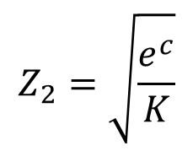
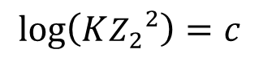
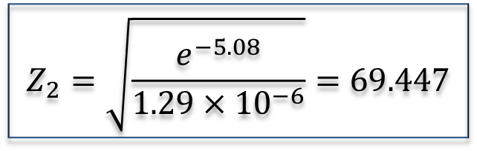
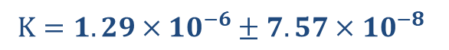
Determining the atomic number of gold: Z₂
We have an intercept from the logarithmic fit
$$Z_{2}=\sqrt{\frac{e^{c}}{K}}$$
$$\log\left(K{Z_{2}}^{2}\right)=c$$
Earlier, we found
$$K=1.29×{10}^{−6}±7.57×{10}^{−8}$$
$$Z_{2}=\sqrt{\frac{e^{−5.08}}{1.29×{10}^{−6}}}=69.447$$

Slide 34
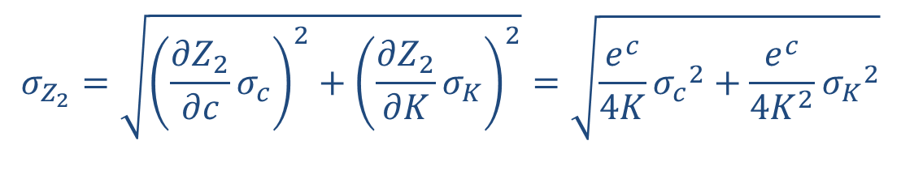
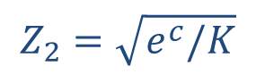
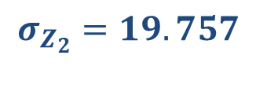
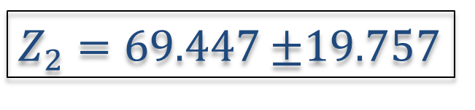
Error in Z₂
$$Z_{2}=\sqrt{e^{c}/K}$$
We can propagate the error in
$$σ_{Z_{2}}=\sqrt{{\left(\frac{∂Z_{2}}{∂c}σ_{c}\right)}^{2}+{\left(\frac{∂Z_{2}}{∂K}σ_{K}\right)}^{2}}=\sqrt{\frac{e^{c}}{4K}{σ_{c}}^{2}+\frac{e^{c}}{{4K}^{2}}{σ_{K}}^{2}}$$
$$σ_{Z_{2}}=19.757$$
$Z_{2}=69.447$ $±$19.757

Slide 35
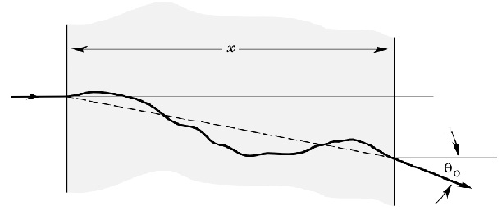

Multiple Scattering
Repeated elastic collisions with nuclei (low probability)
Energy transfer is negligible but small angular deviations
This is true for thick materials
Image courtesy of Meroli [8]
Quantitatively: We use the method here [9]
Geometric cross section – ratio of nucleus to atom: $3.45×{10}^{8}$
Probability of hitting nucleus: $1/3.45×{10}^{8}$
Targets have to cover 1% area to have 1% probability of scattering
Then: to have 1% chance of multiple scattering $t=900μm$

Slide 36

Energy losses
Energy loss due to inelastic collisions with electrons
For thin foils, usually negligible
Passing through matter and also angular dependence
Quantitatively [10]: Non-relativistic Bethe-Bloch formula (I: mean excitation energy)
$$−\frac{dE}{dx}=\frac{4πnZ^{2}}{E}{\left(\frac{e^{2}}{4πε_{0}}\right)}^{2}\ln\left(\frac{2E}{I}\right) where I=10eV∗Z and n=\frac{ZρN_{0}}{A}$$
$$−\frac{dE}{dx}=1.315 MeV/cm$$
Additionally: Bremsstrahlung or braking radiation – electrons and alpha particles interacting – deceleration

Slide 37
References
[1] Image ref, https://en.wikipedia.org/wiki/Plum_pudding_model
[2] Image ref, https://commons.wikimedia.org/wiki/File:ScatteringDiagram.svg
[3] A. C. Melissinos, Experiments in Modern Physics, (1966)
[4] R. S. Quimby, Photonics and Lasers, An Introduction, (2006)
[5] Knoll, Radiation Detection and Measurement, John Wiley and Sons, New York (1979)
[6] D. Orlandolo, Rutherford Scattering, 2018.
http://experimentationlab.berkeley.edu/sites/default/files/writeups/RUT.pdf
[7] R. D. Evans, The Atomic Nucleus. McGraw Hill (1972)
[8] S. Meroli, Multiple scattering for particles in the matter, 2012
http://meroli.web.cern.ch/meroli/lecture_multiple_scattering.html
[9] Multiple scattering, Hyperphysics
http://hyperphysics.phy-astr.gsu.edu/hbase/Nuclear/mulscat.html
[10] J.R. Comfort et al., “Energy Loss and Straggling of Alpha Particles in Metal Foils”; Physical
Review 150, 249 (1966)

